Slide 1
Choosing Reverie: Do People Like To Think?
Erin C. Westgate, Timothy D. Wilson
University of Virginia
Notes:
I ‘m interested in whether people enjoy being alone with their thoughts in the absence of external stimulation. Today I want to talk about intentionality – does it make a difference if we choose to entertain ourselves with our thoughts or is it better somehow if it happens spontaneously?

Slide 2
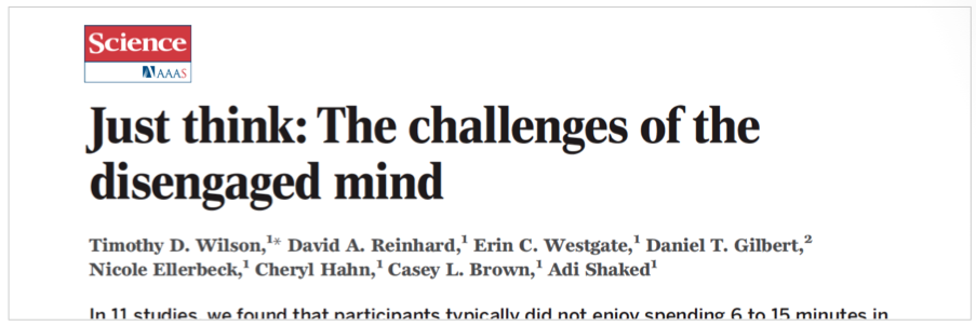
Is spontaneous reverie more enjoyable?
Notes:
We know from our past research that when we ask people to entertain themselves with their thoughts in an empty room, with no distractions, many people don’t enjoy it very much. Most people report enjoying external activities much more and some people even go so far as to to give themselves an electric shock rather than just think. But of course, that’s when we asked people to think intentionally – people might enjoy thinking more when it happens spontaneously. So we decided to see if people enjoy intentional thinking in everyday life and if spontaneous reverie is more enjoyable.

Slide 3
Notes:
We followed 170 undergraduates for a week using experience sampling. We texted them four times a day for seven days, and each time we asked them to categorize their thoughts and then answer some questions, such as how much they were focused on the external world versus on their own thoughts, how much they wanted to be having those thoughts, and whether they intentionally decided to initiate those thoughts.
Participants
171 undergraduates (119 female, 50 male, 2 declined to answer)
Ages 18-22(Mean age = 18.83, SD = 1.09)

Slide 4
Is it common?
Notes:
We used people’s answers to come up with a lot of different thought categories. As others have found, external thought was very common. there were lots of kinds of internal thought, but today I want to focus on just two: intentional reverie ( when people are deliberately trying to pay attention to their internal thoughts and want to be having those thoughts) and spontaneous reverie, wanted internal thought that occurs unintentionally . If if you look at intentional reverie in orange, you can see that people reported INTENTIONALLY entertaining themselves with their thoughts 7.9% of the time. In contrast, for spontaneous reverie in yellow shows people reported SPONTAENOUSLY entertaining themselves with their thoughts a little less often, just 6.8% of the time. So people were entertaining themselves with their thoughts, both intentionally and spontaneously – but not terribly often. Did they enjoy it when they did?

Slide 5
Is it pleasant?
Intentional
Reverie
(7.9%)
Spontaneous
Reverie
(6.8%)
Notes:
Participants rated thought valence on a 1 to 7 scale, with 1 being negative and 7 positive. And of course, as expected, when we look at wanted vs unwanted thoughts, wanted thoughts are much more positive. But we want to compare intentional and spontaneous thoughts. If we look at just wanted thoughts and compare those, we see two things. First intendional wanted internal thought, or intentional reverie, was moderately positive in valence. And second, spontaneous wanted thought – or spontaneous reverie - was even more positive. And if we look at mood, we see the same pattern. Intentional reverie was associated with mildly positive moods, but spontaneous reverie was even more positive . We see the opposite pattern for unwanted thoughts, for both mood and valence

Slide 6
Questions
Can we test this experimentally?
Is spontaneous reverie easier because it’s less cognitively demanding?
Can we make intentional reverie more enjoyable by making it less demanding?
Notes:
In summary people do enjoy entertain ing themselves with their thoughts, at least some of the time, but it’s not very frequent and not everyone’s reporting it. It’s also possible that spontaneous reverie simply be more pleasant than intentional reverie. Obviously, there are a lot of reasons why spontaneous reverie might be more enjoyable, and it would be really nice to manipulate people’s thoughts experimentally. If spontaneous reverie really is more enjoyable, it could be because it’s easier – you don’t need to pick a topic or consciously initiate a train of thought. It just happens. One reason people in our earlier studies may not have enjoyed thinking very much is because we were asking them to do it on demand, which was just hard. That’s an idea we’re exploring right now. If it does turn out that spontaneous reverie is more enjoyable because it’s less cognitively taxing, that also suggests that we could make intentional reverie more enjoyable by finding ways to make it less demanding, either by giving people practice or offering other mental aids or crutches that could help people enjoy being alone with their thoughts when they choose to do so.

