Slide 1
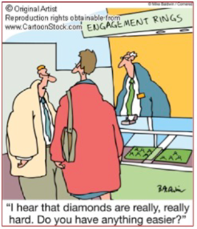
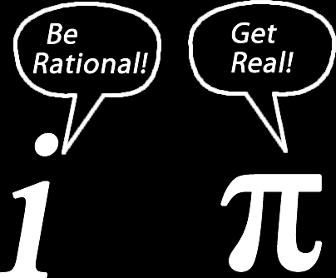
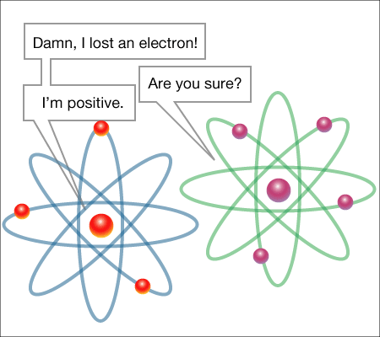
Science is a Joke!
Conceptual Humor as a Tool for Increasing Student Engagement and Performance in Science
Erin Westgate¹ ¹Department of Psychology, University of Virginia
Background
The tendency of students to lose interest in the STEM (Science, Technology, Engineering, Mathematics) fields and slowly disengage over time has been dubbed the “leaky pipeline problem.” As students proceed through the lower grades and experience loss of interest and perceived competence, they become less likely to seek out STEM fields and occupations when they are older. One potentially overlooked tool for preventing this loss of interest and engagement in science is the deliberate and systematic use of humor in classroom instruction and materials. Humor has been shown to reduce stress and increase coping in the health literature and may have positive effects on memory by drawing attention to key concepts.
Students consistently report they enjoy the use of humor in their classes (Lowman, 1994). Furthermore, professors who receive high ratings on their teaching ability usually express a personal teaching philosophy that includes and emphasizes the importance of humor (Bryant, Crane, Cominsky, & Zillman, 1980). Students also feel they learn more when humor is incorporated into classes, and students who report that their instructors use humor in their lessons also report higher perceived learning (Wanzer & Frymier, 1999).
What Is Conceptual Humor?
Conceptual humor is humor that is illustrative of the concept being taught. In other words, if a person remembers the “joke,” then by definition they will also remember the concept that was the subject of the joke. Although non-conceptual and irrelevant humor may reduce anxiety and ease social and academic pressures in the classroom, humor must be related to the topic at hand for it to have a positive effect on students’ interest and memory. Humorous material attracts greater attention from individuals (Schmidt 2002), and attention is a critical step to encoding information in memory. It does little good to remember a joke unrelated to the course topic. On the other hand, when humor is conceptually illustrative of the material being taught, it has the benefit of making essential information easier to retrieve and remember. Furthermore, it may inspire genuine interest in the topic itself, by inviting students to engage in material they may otherwise have avoided and actively enjoy that experience.
Discussion
Non-STEM major students who viewed a version of a geology lecture incorporating conceptual humor were more likely to indicate interest in geology both immediately after viewing the lecture and two weeks later than students who viewed a non-humorous or non-conceptual humor version of the video.
Non-STEM major students who viewed the conceptually humorous version of the lecture remembered and understood significantly more of the lecture concepts two weeks later than students who viewed a different version of the lecture.
These findings lend support to the idea that humor may be a potential effective tool in science education for students who may otherwise lack interest or engagement, by increasing interest and competence in science.
The results also suggest that performance and/or interest benefits may grow with time. Future research should address whether the benefits of using conceptual humor may have a compounding effect over time.
Instructors should be encouraged to incorporate conceptual humor into their lesson plans. While further research is required to understand how and when such use of humor is most effective, studies to date suggest that conceptual humor does not harm students’ interest or performance and may actually have beneficial effects. This may be of particular interest to math and science educators, given the worrying tendency of many students to disengage in these areas over time.
Does it Work?
Participants: 42 American college undergraduate non-STEM majors, i.e.,
not majoring in science, technology, engineering or math
Methods
Session 1: Lab Session
View one version of 10-minute geology lecture:
No Humor
Non-conceptual Humor
Conceptual Humor
Measures of interest in geology, recall and comprehension
Session 2: Online Follow-Up Two Weeks Later
Additional measures of interest in geology as well as recall and comprehension of lecture material
Results
Interest - Non-STEM majors who viewed the conceptual humor version of the lecture reported increased interest in geology immediately afterwards (p < .05). They continued to show more interest in geology two weeks later (p < .05) compared to students who viewed a different version of the lecture.
Performance – Non-STEM majors who viewed the conceptual humor version of the lecture did not experience improved performance immediately (p = .39), but did experience improved recall and comprehension of the lecture concepts two weeks later compared to non-STEM majors in the “no humor” or “non-conceptual humor” conditions (p < .05).
Examples
Conceptual Humor: “The first [property of a mineral]: it has to be naturally occurring. So if you have ice on a pond, that’s a mineral, but if you make ice for your margaritas, then that’s not a mineral.”
Non-conceptual Humor: “You may have thought streak was what minerals do when they aren’t wearing clothes, but actually no minerals wear clothes.”
No Humor: “Pyrite or fool’s gold looks like gold naturally but if we powder it, it gives us a black streak, so we can tell it from real gold, which would give us a gold streak.
References
Bryant, J., Crane, J.S., Cominsky, P.W., & Zillmann, D. (1980). Relationship between
college teachers use of humor in the classroom and students evaluations of their teachers. Journal of Educational Psychology, 72, 511-519.
Lowman, J. (1994). Professors as performers and motivators. College Teaching, 42,
137- 141.
Schmidt, S. (2002). The humor effect: Differential processing and privileged retrieval.
Memory, 10, 127-138.
Wanzer, M., & Frymier, A. (1999). The relationship between student perceptions of
instructor humor and students reports of learning. Communication Education,
48, 48-62.
These data were collected as part of an undergraduate senior thesis under the guidance of
Jennifer Henderlong Corpus.
Questions? Contact: Erin Westgate, ecw4za@virginia.edu
Notes:
This poster template is from http://www.swarthmore.edu/NatSci/cpurrin1/posteradvice.htm. It is free, free, free for non-commercial use. If you really like it, I’m always thrilled to get postcards from wherever you happen to be presenting your poster. -- Colin Purrington, Department of Biology, Swarthmore College, Swarthmore, PA 19081, USA. cpurrin1@swarthmore.edu
1

